Slide 1


Slide 2

NLP Chatbot Development using Dialogflow

Slide 3
Group Members Introduction
Degree Program: BS Software Engineering
Group ID: F24PROJECTA15B3
Member: Ilsa (BC210203055) –
Solo Project Designer and Developer

Slide 4

INTRODUCTION OF PROJECT
NLP Chatbot Development Using Dialogflow” is designed to enhance customer interactions for a pharmacy store.
PROJECT OVERVIEW:
This chatbot will act as a virtual assistant, available 24/7, to assist pharmacy customers.
It aims to address common customer needs, minimize wait times, and provide a seamless, conversational interface for the pharmacy's digital services.
A secure and reliable user authentication to access the platform by securing login credentials.

Slide 5
Modern pharmacies often struggle with efficiently managing customer interactions due to high foot traffic and limited staff. This results in delays when handling frequent product inquiries, orders placements, delivery requests, and medicine tracking. Such inefficiencies lead to long waiting times, frustrated customers, and a drop in overall satisfaction.
To solve this, I developed an NLP Chatbot using Dialogflow — designed to:
Provide real-time product availability updates.
Order placements and feedback.
Manage and process delivery requests.
Set personalized medication tracking.
With natural, intuitive conversations, the chatbot will automate routine tasks, reduce staff workload, and deliver a faster, more satisfying customer experience.

Slide 6
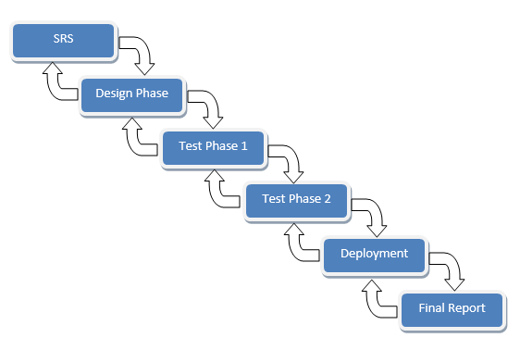
VU Process Model

Slide 7
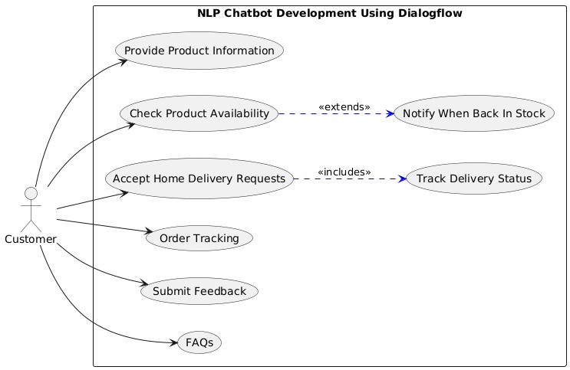
Use Case Diagram

Slide 8
Business Rules Catalog
User Authentication: The system must support secure registration, login, and password recovery through OTP to verify for password update and authenticate users before granting access.
Roles: The platform must distinguish between admin and user roles to enable appropriate access to features like order management, tracking, and dashboards.
Order Placement: Users must be able to place medicine orders via the chatbot, which captures medicine name, quantity, delivery location, and stores it in the database.
Order Tracking: Users can track their order status using order ID; system returns real-time or default status (e.g., “Pending/Delivered”).

Slide 9
Business Rules Catalog
Admin Control: Admin must be able to view all orders from all users and update order statuses for tracking purposes.
User Control: User must be able to view order history and see order statuses for tracking purposes.
Data Management: The system must maintain structured records of users, medicines, orders, and feedback in a backend SQL database.
Integration with Dialogflow: The system should interact with Dialogflow intents to handle NLP-based queries for ordering, FAQs, and feedback.

Slide 10
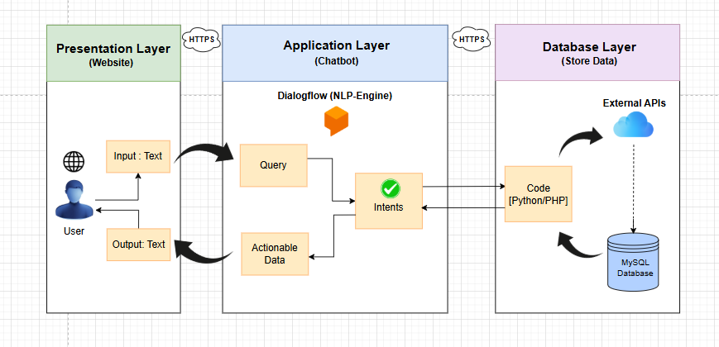
Architectural Design

Slide 11

Team Structure
Abdullah Qamar (Project Supervisor)
Ilsa (BC210203055)
VU Process Model

Slide 12
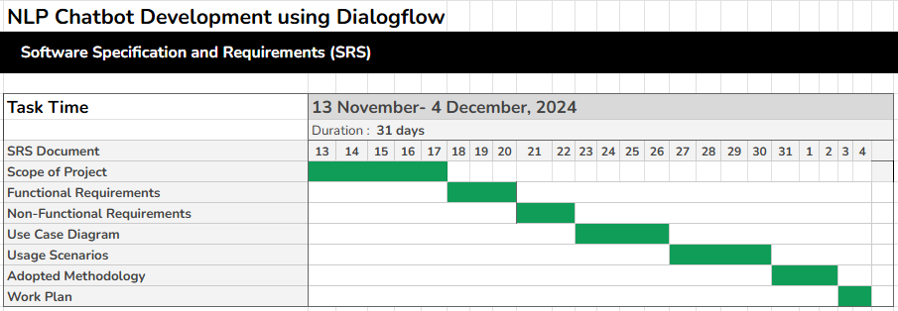
Project Schedule

Slide 13
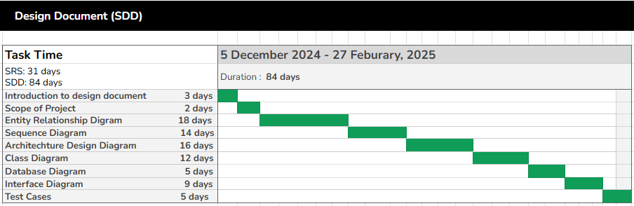
Project Schedule

Slide 14
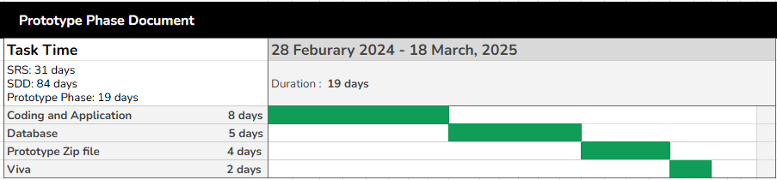
Project Schedule

Slide 15
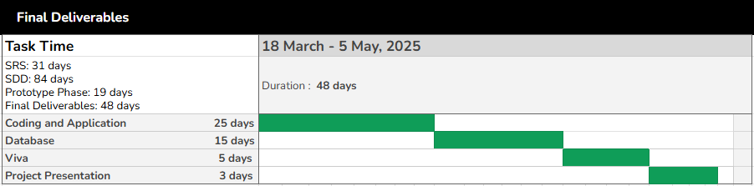
Project Schedule

Slide 16
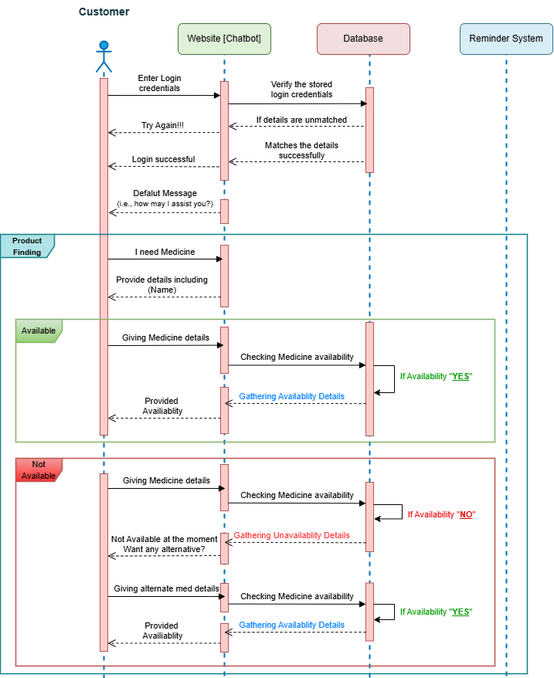
Sequence Diagrams

Slide 17
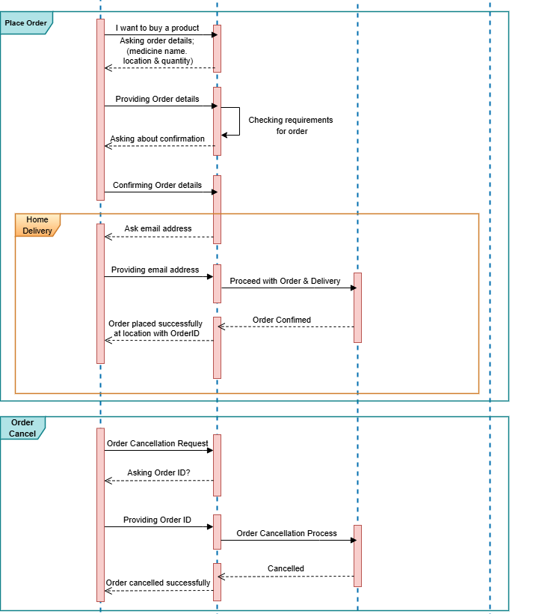
Sequence Diagrams
Order Placement

Slide 18
Sequence Diagrams
Order Cancellation

Slide 19
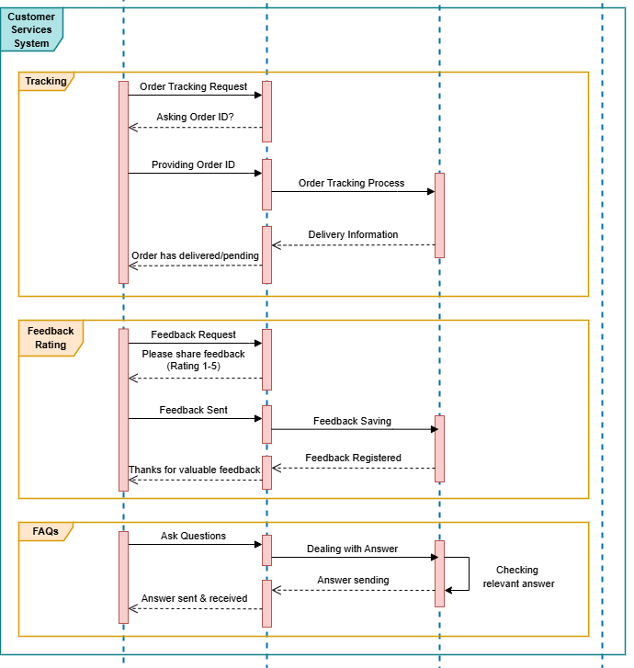
Sequence Diagrams
Customer
Support

Slide 20
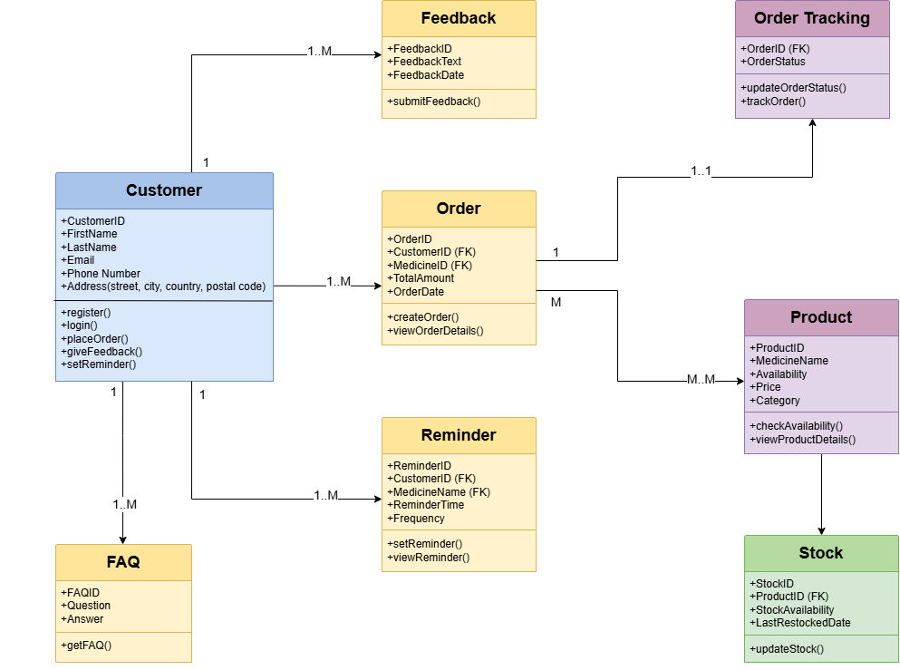
Logical Model/Class Diagram

Slide 21
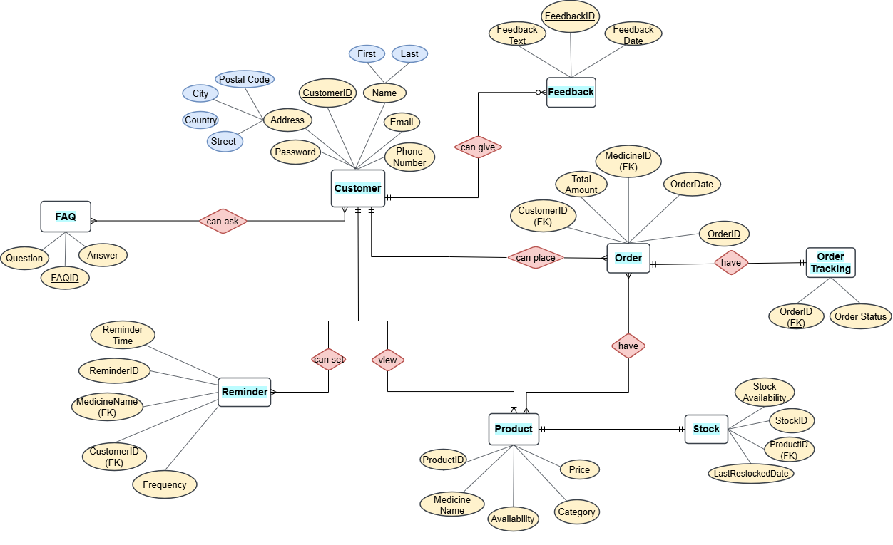
Entity-Relationship Diagram

Slide 22
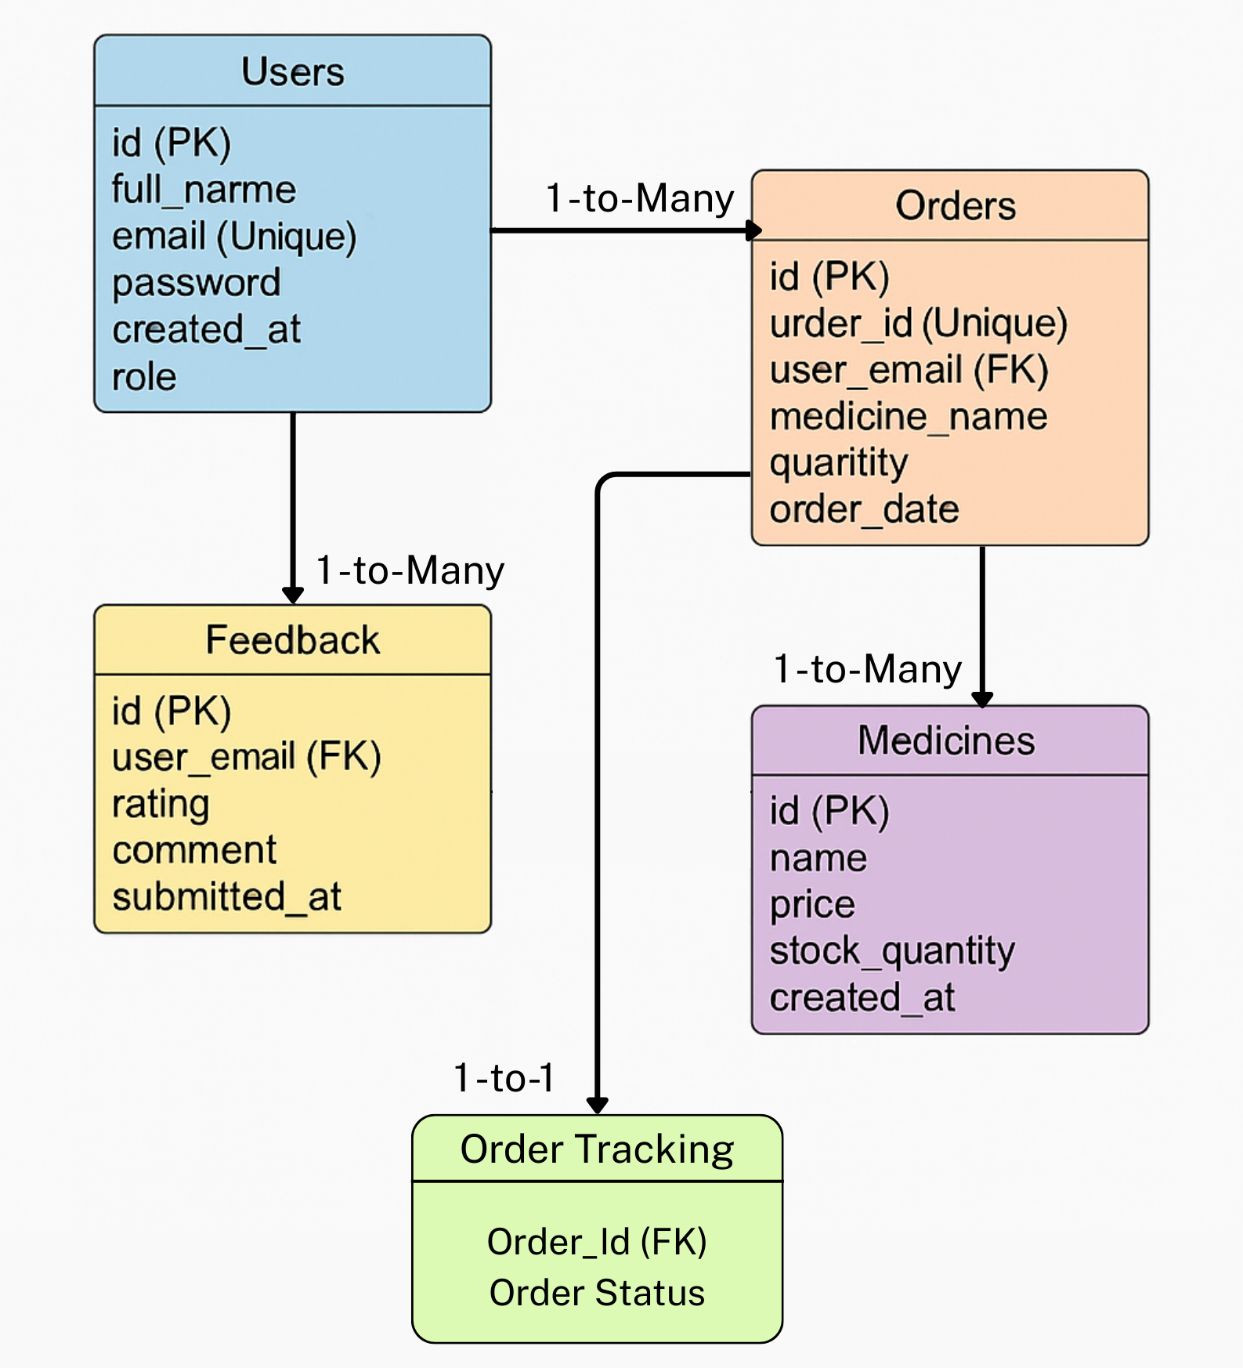
Database Diagram

Slide 23
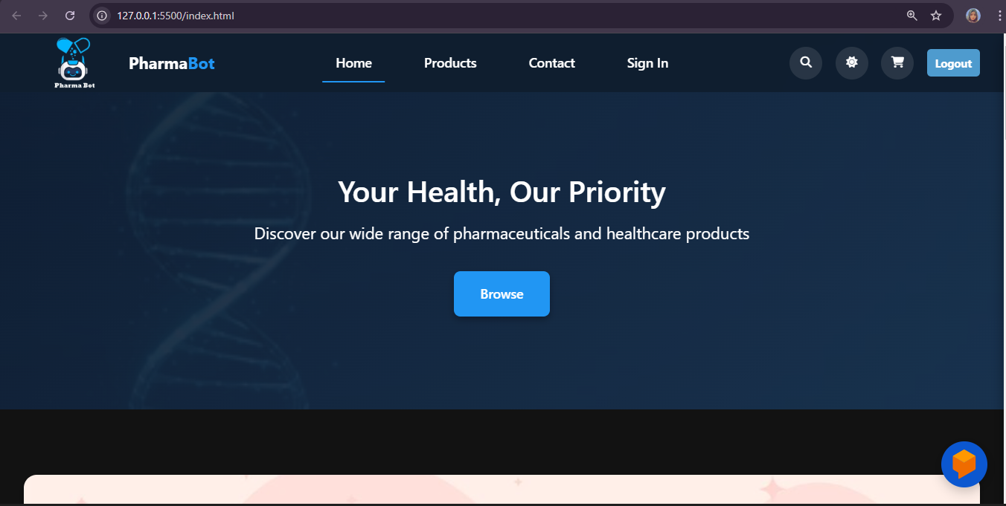
User Interfaces
Home Page

Slide 24
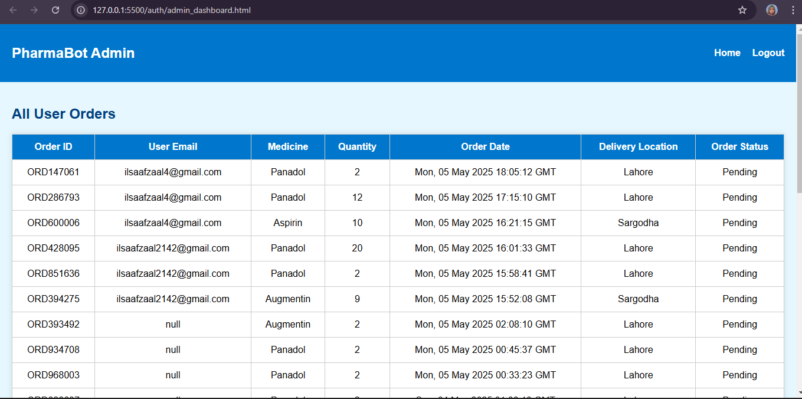
User Interfaces
Admin Dashboard Page

Slide 25
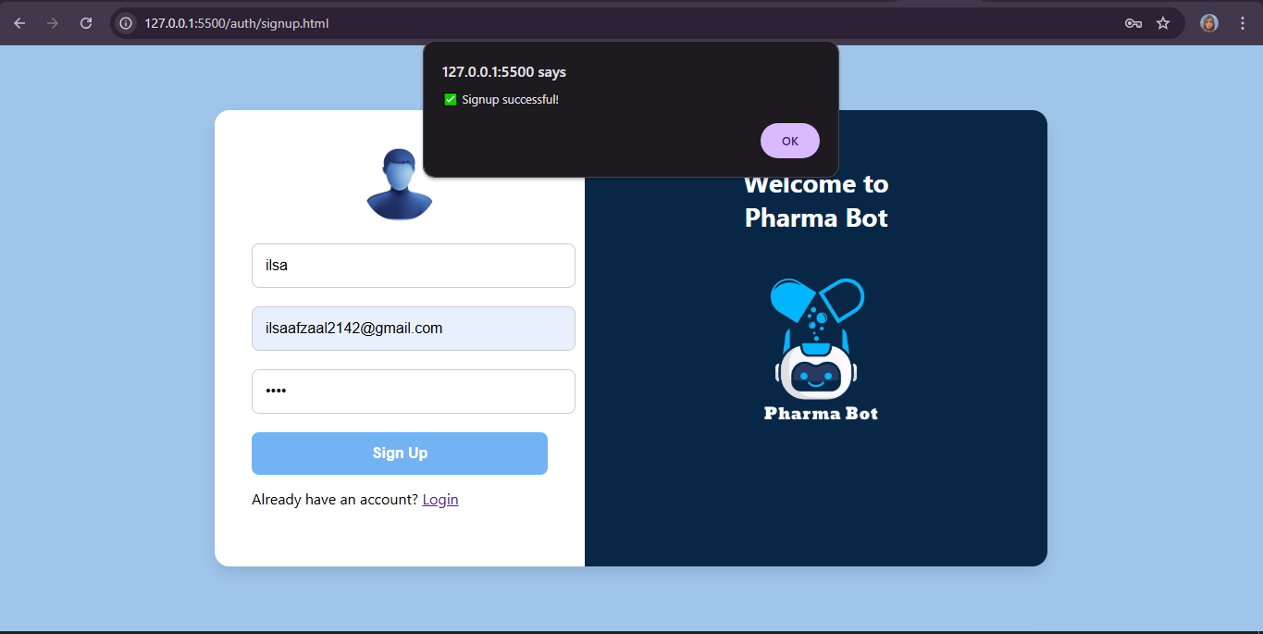
User Interfaces
Sign Up / Registration

Slide 26
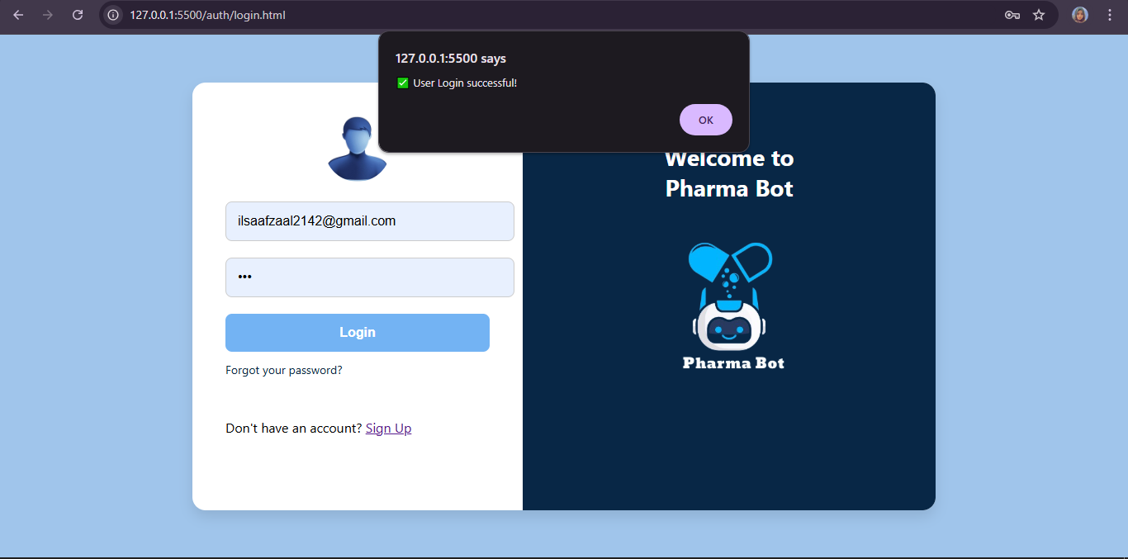
User Interfaces
Login

Slide 27
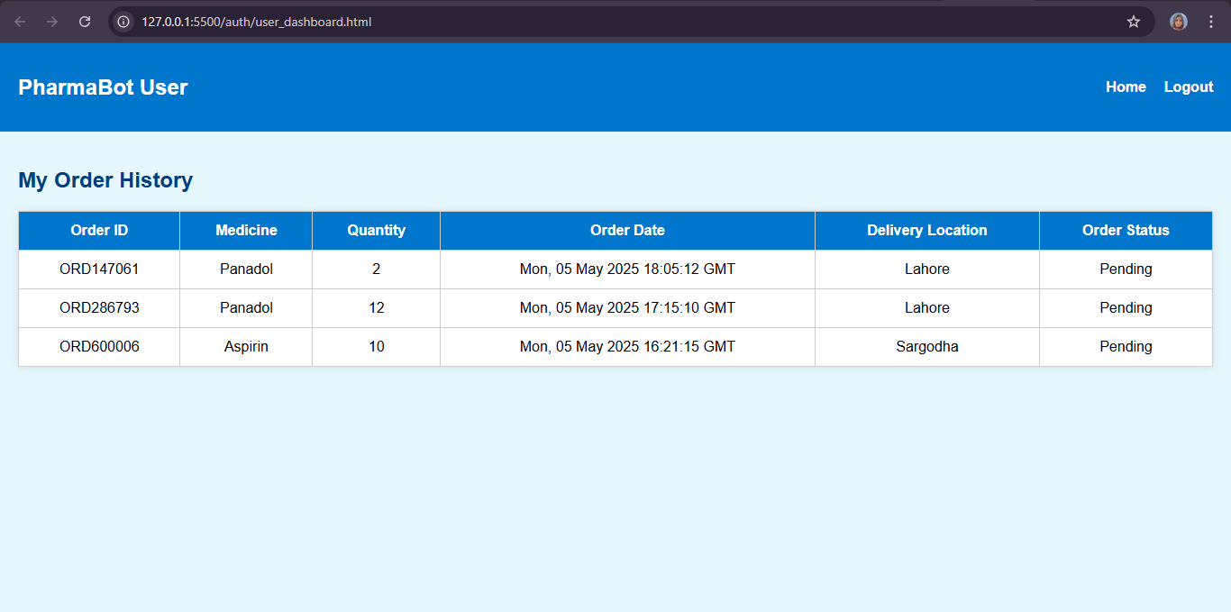
User Interfaces
User Dashboard Page

Slide 28
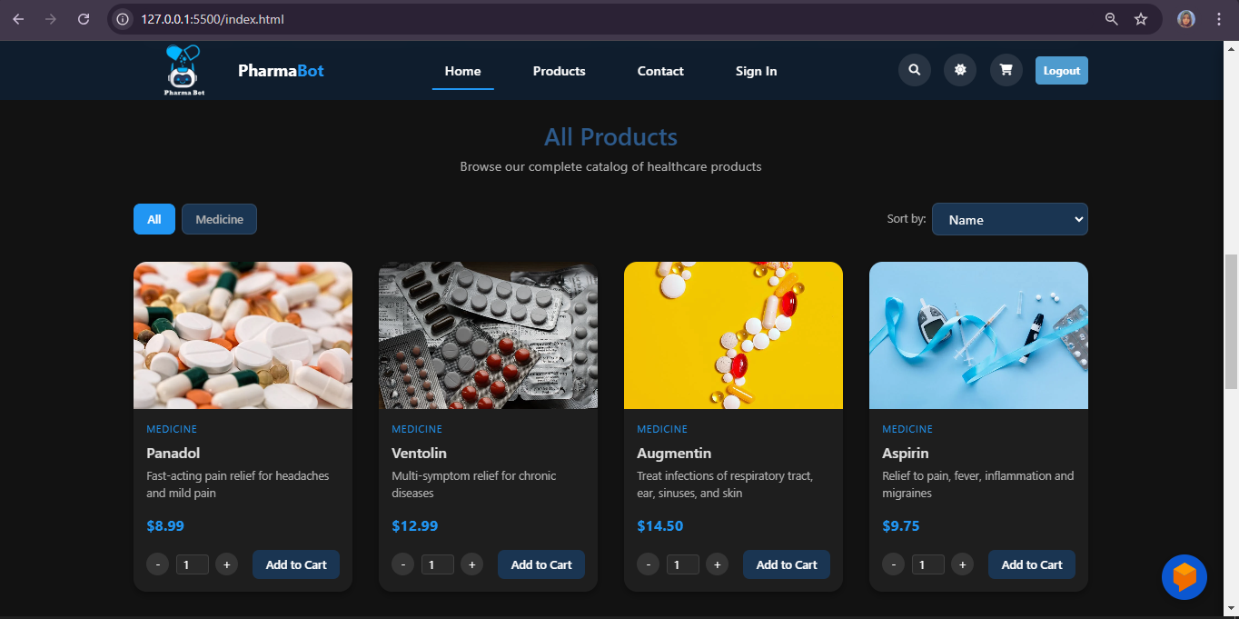
User Interfaces
Available Products (Medicine)

Slide 29
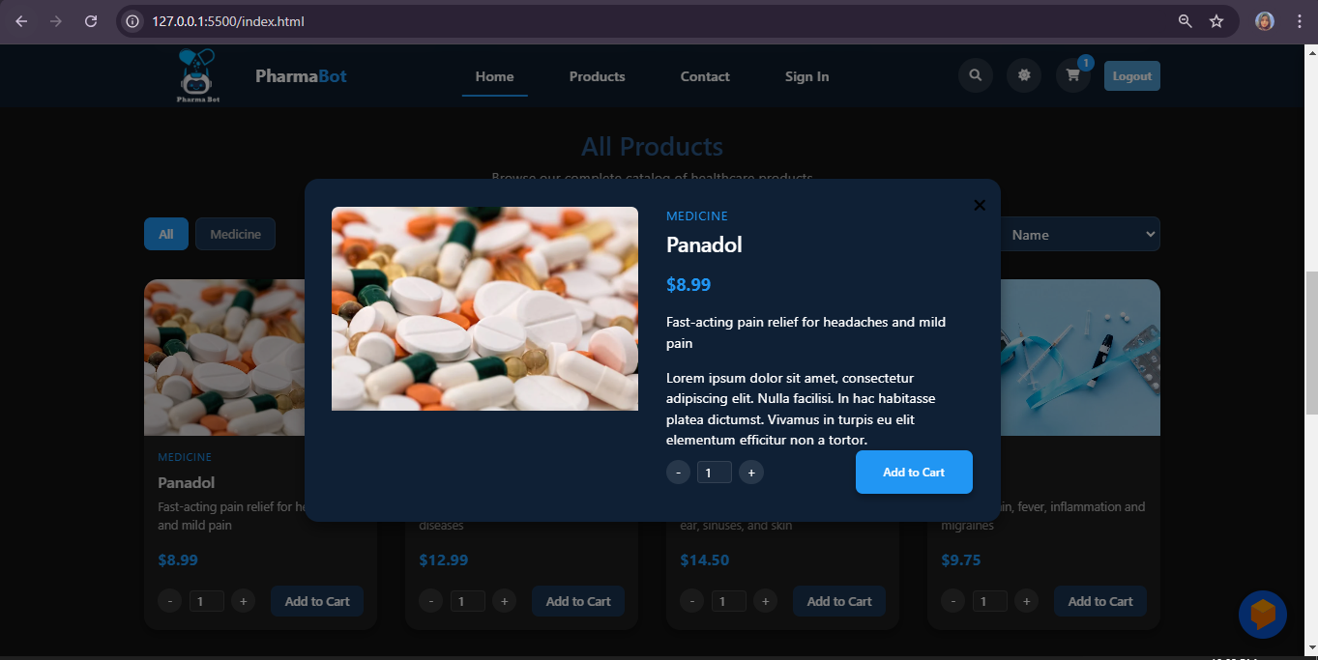
User Interfaces
Medicine Details

Slide 30
User Interfaces
Add to Cart

Slide 31
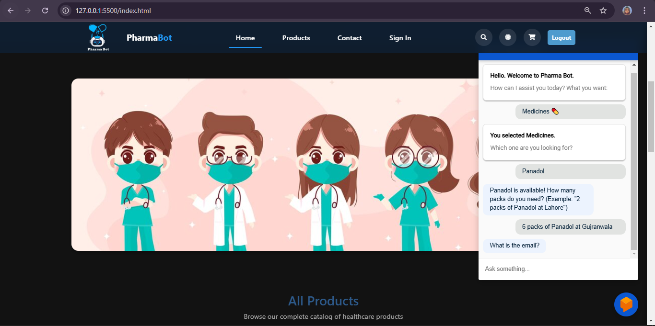
User Interfaces
Ordering

Slide 32
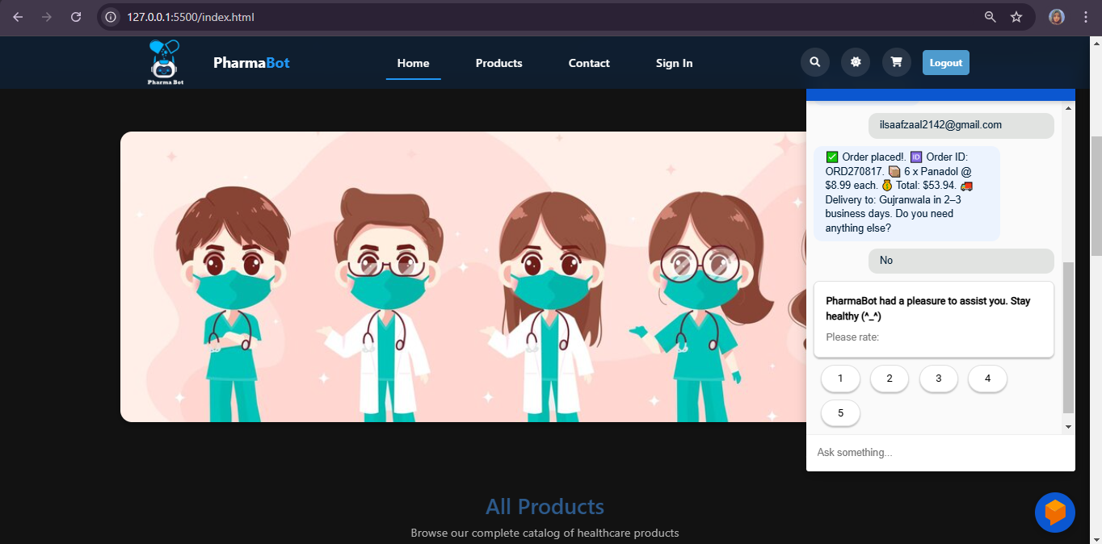
User Interfaces
Feedback

Slide 33
User Interfaces
Order Tracking

Slide 34
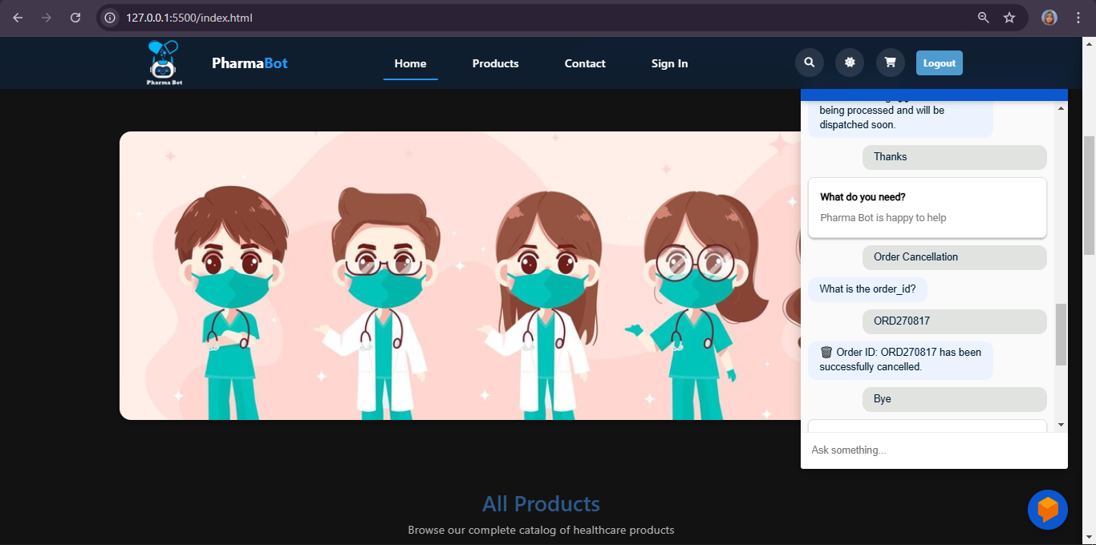
User Interfaces
Order Cancellation

Slide 35
User Interfaces
FAQs

Slide 36
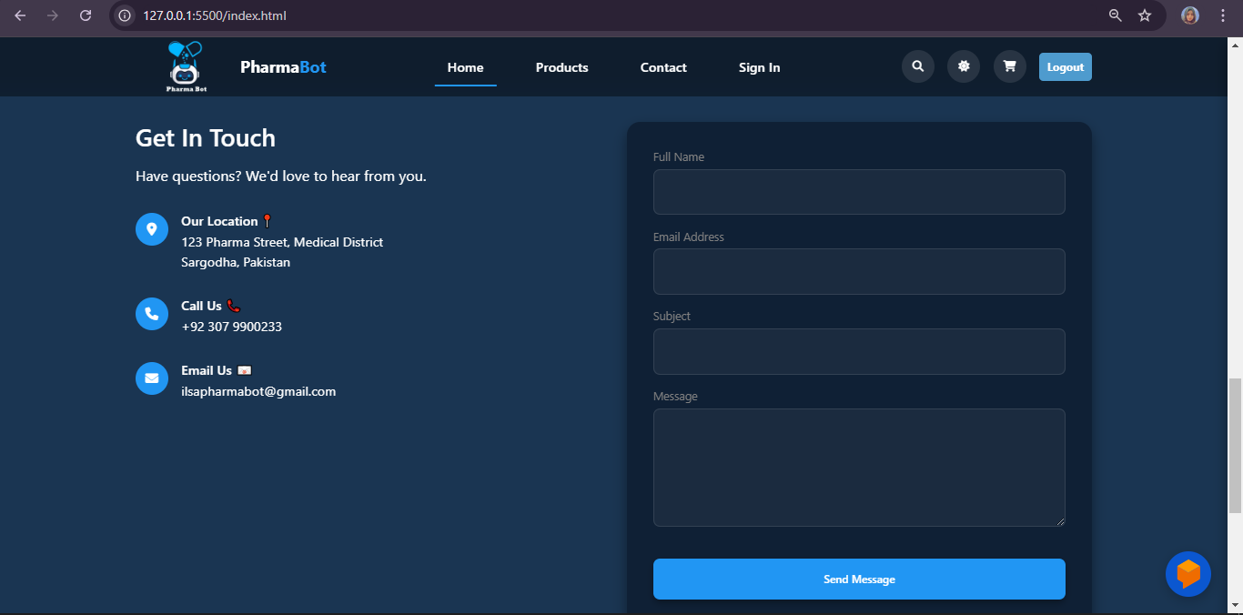
User Interfaces
Contact Us Page

Slide 37
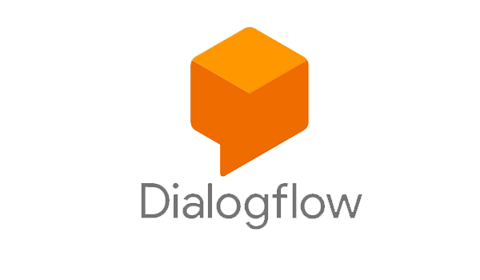

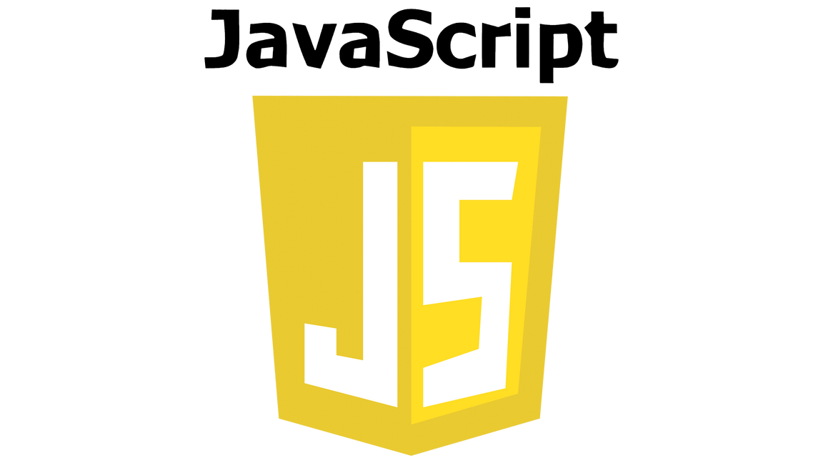

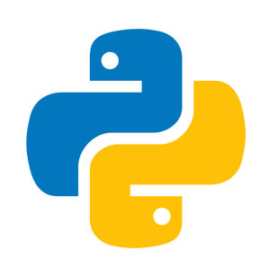

Dialogflow: (Google Cloud NLP) IDE: VS Code Version Control: GitHub Frontend: HTML, CSS, JS Backend: Python (Flask) Database: MySQL (phpmyadmin)
Tools

